Slide 1
NBD1100 Built Environment Communication and Skills

Slide 2
The world’s most well known architect Frank Gehry has recently told the media “98% of everything that is built and designed today is pure shit. There’s no sense of design, no respect for humanity or for anything else.”
One of the reasons behind such a comment is the lack of accessible communication of architecture. Too often architectural concepts are over intellectualised or their communication simply forgotten. This makes it hard for a variety of audiences to understand their true intention. Many architectural outcomes do have relevant concepts and address social issues however most are poorly communicated.

Slide 3
Diagrams
promote clarity and remove pretension from the design process
Example:
BIG’s diagrams for West 57th, the Meatpacking District, New York City

Slide 4
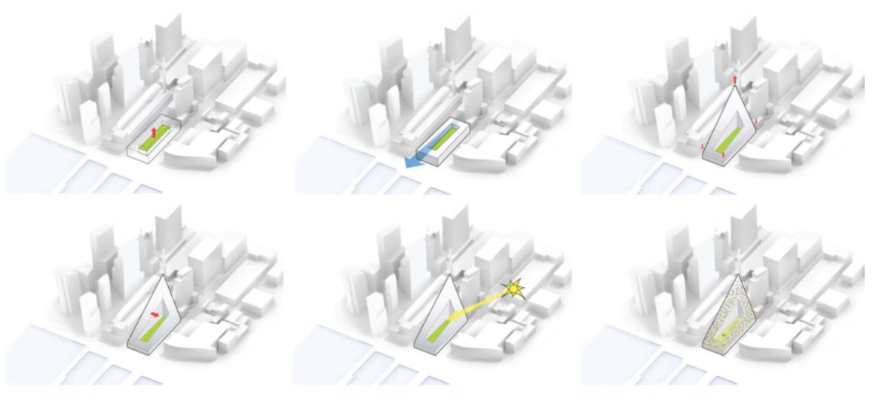

Slide 5
Models
From the tiniest maquettes to the most epic dioramas, models in particular can serve to communicate the essence of a project more succinctly than almost any other medium.
Example:
Richard Meier Model Museum
Europa City walkthrough by Squint/Opera

Slide 6
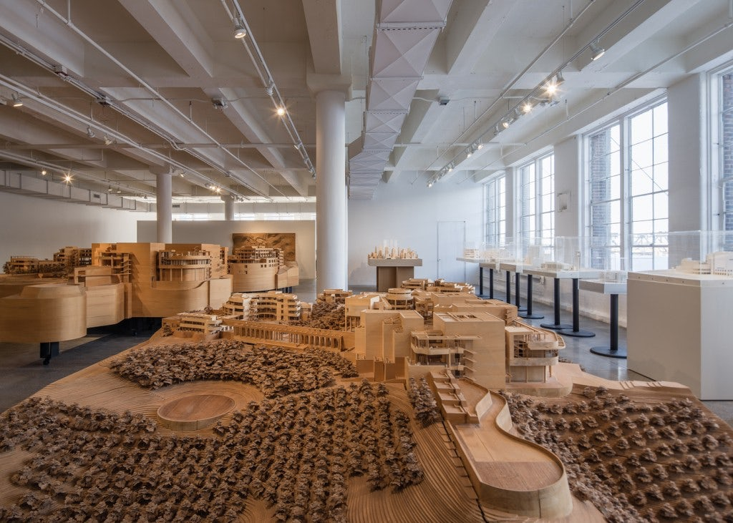

Slide 7


Slide 8

Presentation

Slide 9
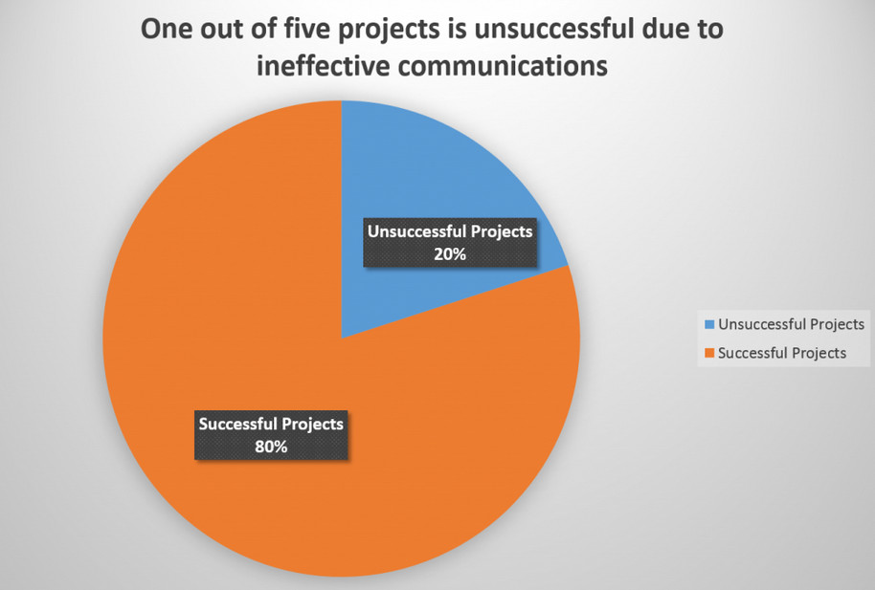

Slide 10
Problem solving through communication

Slide 11
Problem: Outdated Processes
Solution:
  review existing processes and identify which ones are missing
  Define the processes one at a time with the teams that will be impacted by it
  have the processes in place, ensure maximum awareness

Slide 12
Problem: Inefficiency In Leadership
Solution:
  Develop & maintain a communication strategy (encourages openness and honesty & healthy exchange of ideas)
  Be precise
  Regularly-scheduled meetings
  Set up status reviews, daily check-ins, etc.
  Live interactions
  Discuss identified issues
  Share the right direction with actionable steps

Slide 13
Problem: Not Enough Feedback
Solution:
  Be available to listen to team members and learn from them. But also be honest about the strategy you will use to act on their feedback and ideas
  Try to schedule one-on-one appointments
  Having the right mechanism to invite, collect, review and respond to feedback

